Slide 1
ANR : advancement point

Slide 2
Summary
Esann paper
03
Best classifier
08
Intersubject variability
16
Future Work
24

Slide 3
ESANN PAPER

Slide 4
Context
Many variabilities in EEG BCI (physiological, environmental…)
Many transfer learning method (features adaptation, leave one out…)
New paradigm : Burst Code-modulated Visual Evoked Potential (derived from CVEP)
Are Riemannian Deep Learning Algorithms improving accuracy in Burst-CVEP-based BCI ?
Is it performant in a domain adaptation or domain generalization framework ?
→ Is on par or even better
→ Domain adaptation helps to counter variabilities
4

Slide 5
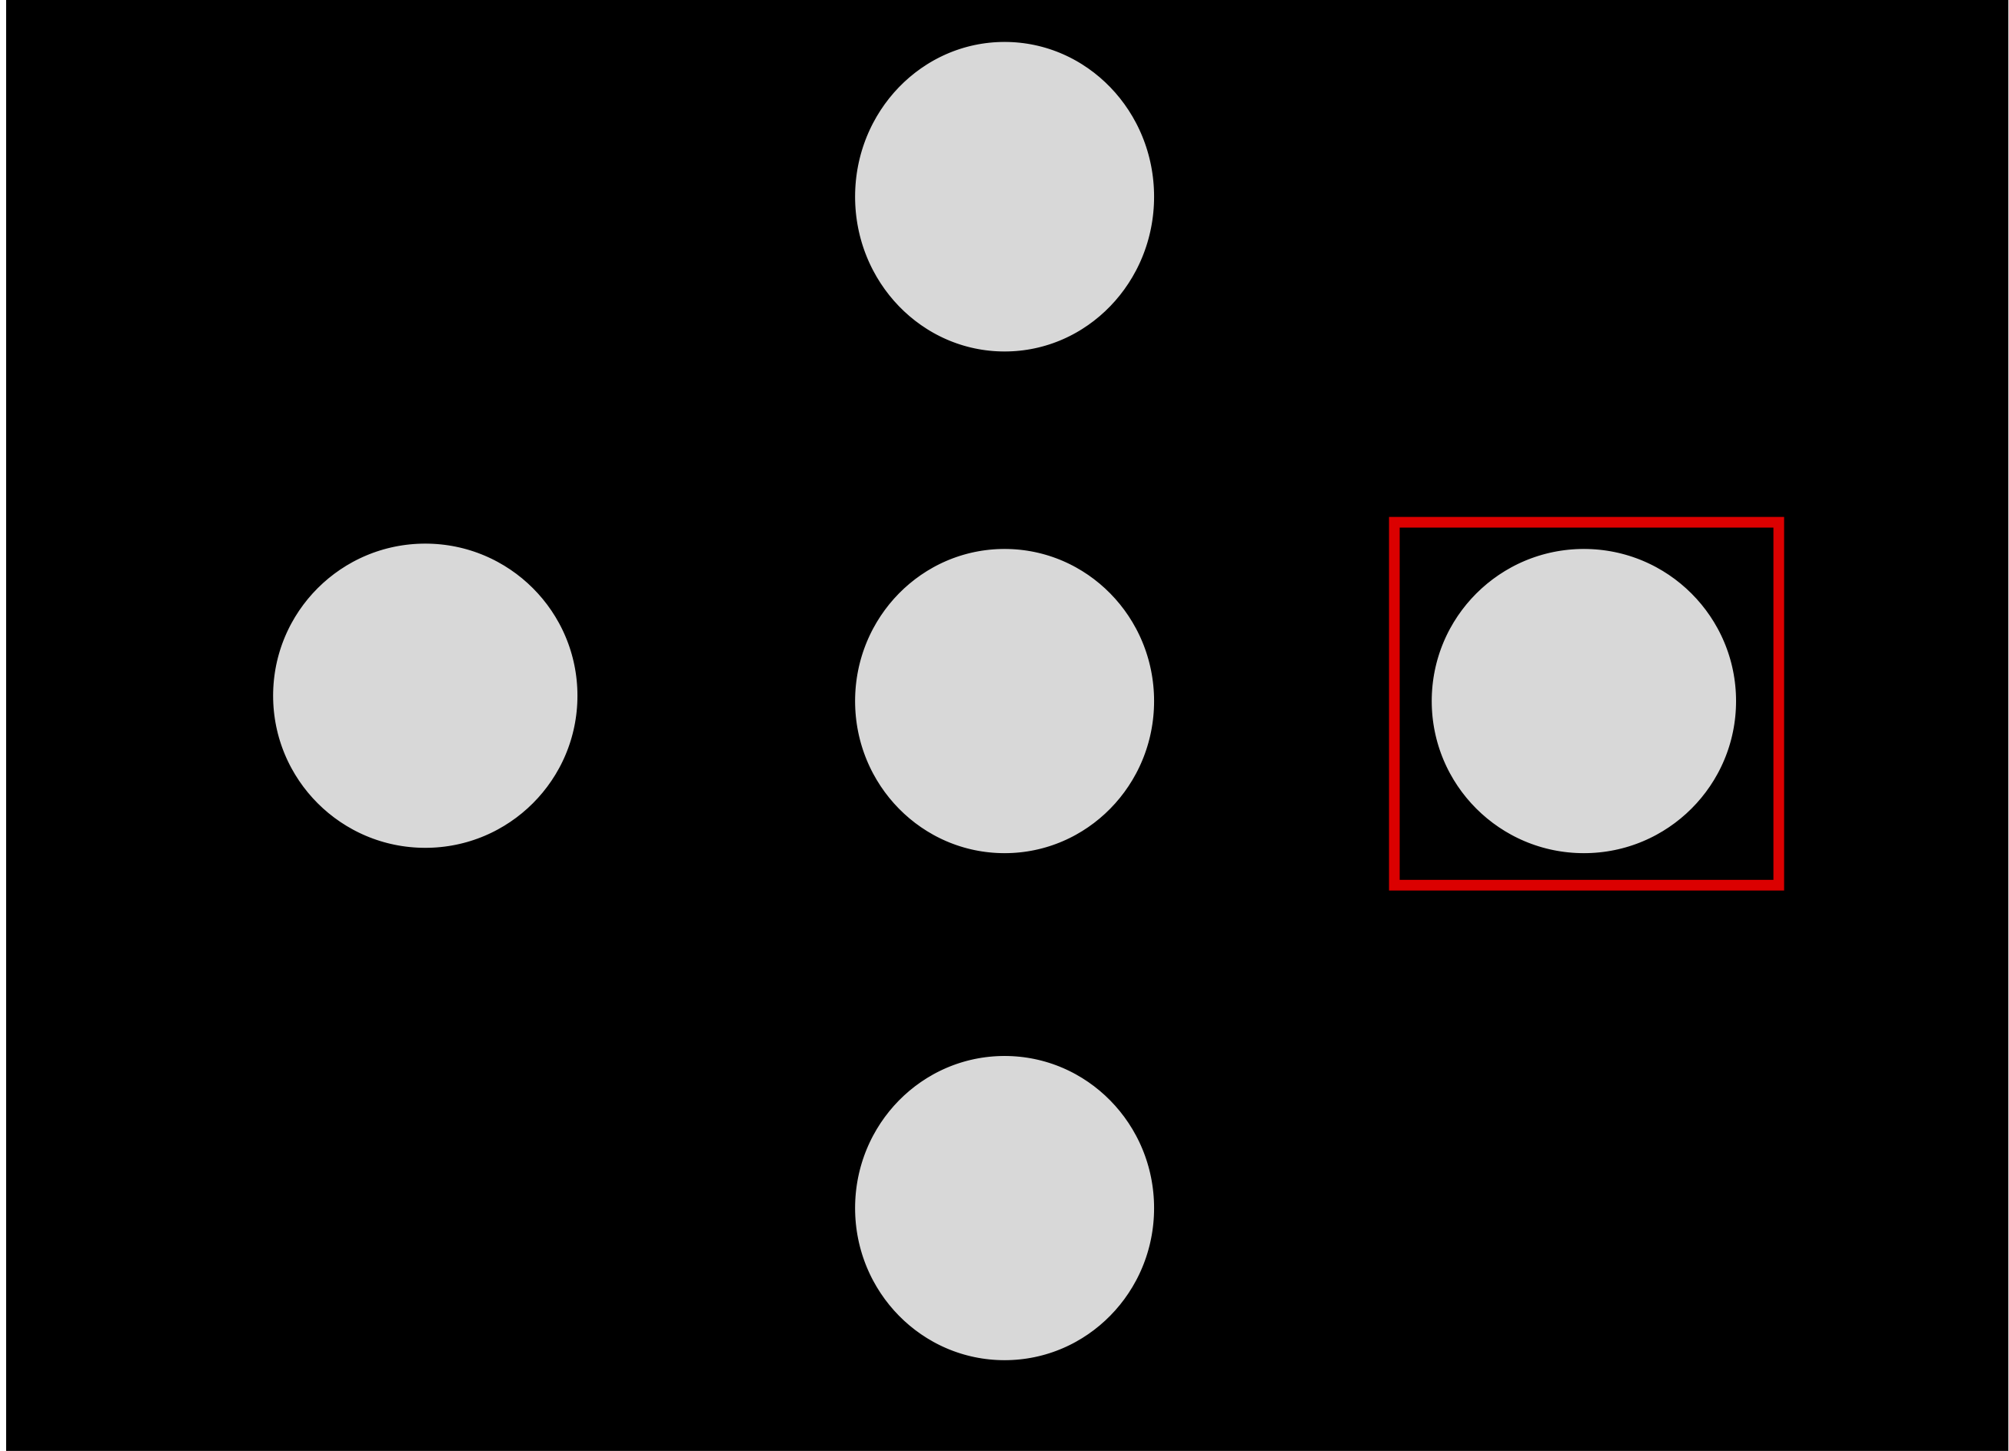
Results
Dataset:
Burst-CVEP and CVEP based EEG
12 participants
1 session each
2 modes : CVEP et Burst-CVEP
15 runs of 4 different 2,2s stimuli each
1
2
4
3
5

Slide 6



Methods
Comparison between CNN and two types of SPDNet
Comparison between Domain Generalization, Domain Adaptation and Single Subject
Normalization, filtering (spatial & temporal), recentering (spatial)
Domain Generalization
(DG)
Training/val data:
N-1 subjects
Testing data:
Nth subject
Domain Adaptation (DA)
Training/val data:
N-1 subjects et a part of Nth subject
Testing data:
Rest of data from Nth subject
Single Subject
(SiSu)
6
Training/val data:
A part of data from subject i
Testing data:
Rest of data from subject i

Slide 7
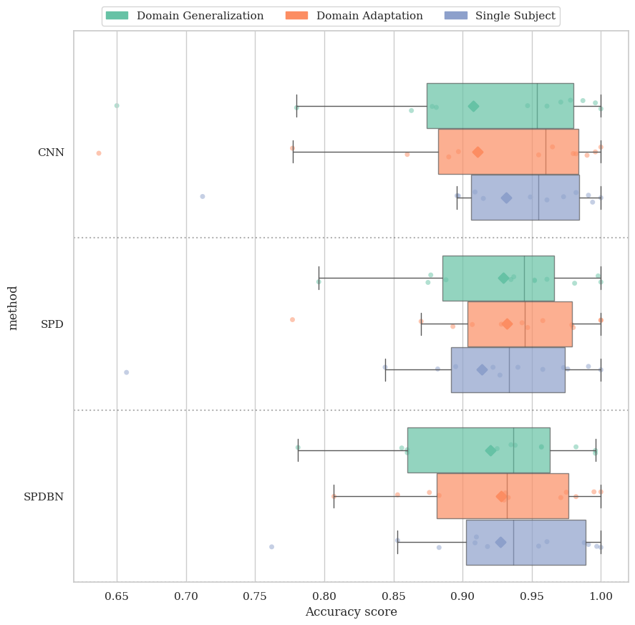
Results
In Burst-CVEP based BCI:
Domain adaptation > Domain Generalization
SPDNet on par with the CNN
SPDBNNet is too slow
7

Slide 8
BEST Classifier for BURST CVEP

Slide 9
Context
Spatial recentering and alignment helps for transfer learning
EEG2Code is well known to be performant for CVEP and XDawn/-TangentSpace-LDA is performant for ERP.
Wavelets transformation create more information (frequency and temporal)
Does spatial recentering and filtering helps to increase performance?
Does GREEN algorithm perform better than classical algorithm (EGG2Code or LDA) ?
→ It helps in DA and SiSu
→ GREEN performs better
9

Slide 10
Methods
Testing well used classifier for CVEP (CNN/EEG2Code) and P300 (Xdawn+TangentSpace+LDA) and GREEN algorithm
In different ways:
CGREEN : Xdawn and alignment are within GREEN
PTGREEN : Pretransformation of the data are made beforehand, then GREEN is applied
TSLDA: XdawnCovariance+TangentSpace+LDA
CNN: CNN derived from EEG2Code
PTCNN: Pretransformation of the data are made beforehand, then CNN is applied
CCNN: Xdawn and alignment are within the CNN
10

Slide 11
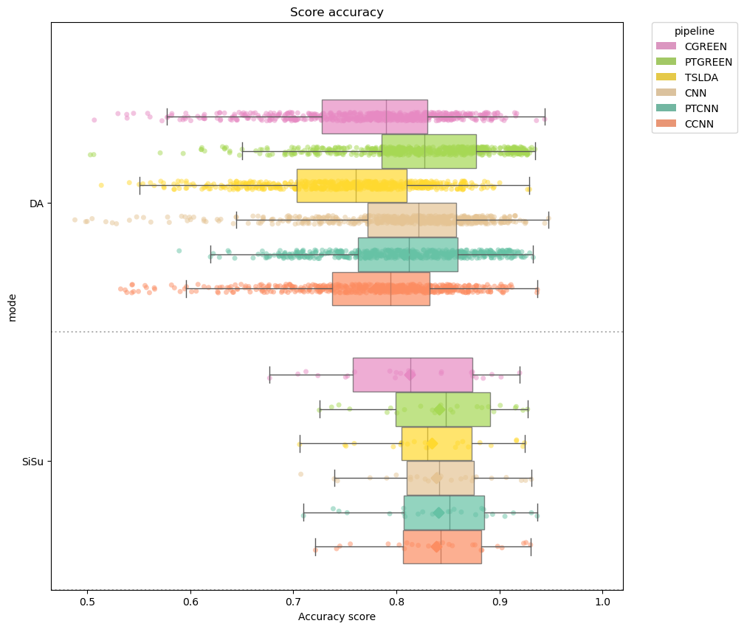
Balanced accuracy for the prediction of the 0 and 1 of the code.
UP: Domain adaptation
Down : Single subject
11

Slide 12
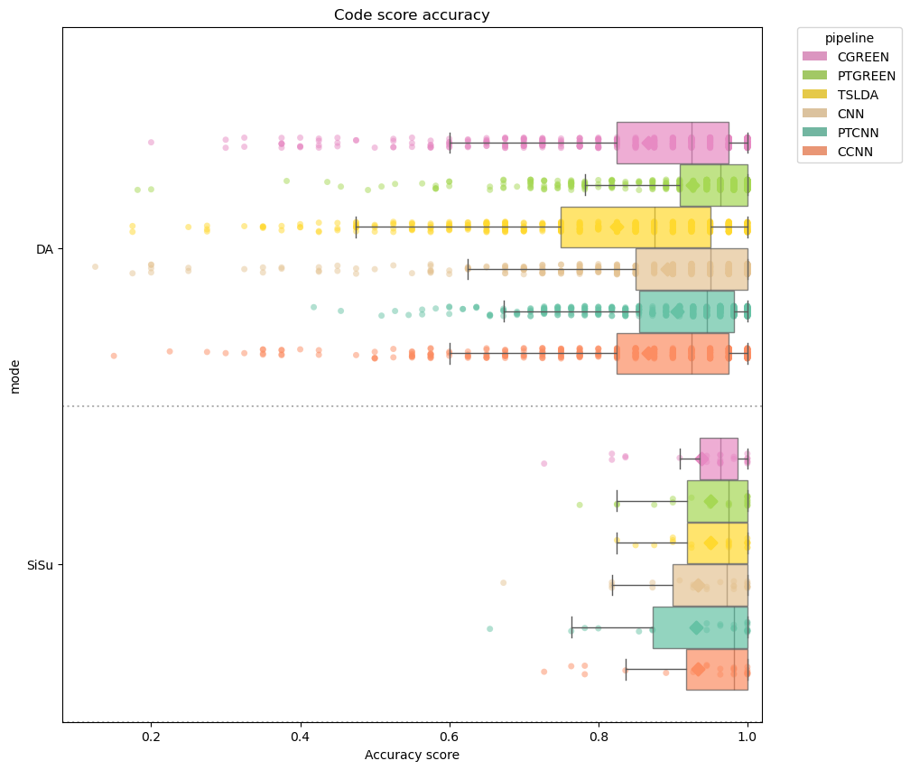
Balanced accuracy for the prediction of the code.
UP: Domain adaptation
Down : Single subject
12

Slide 13
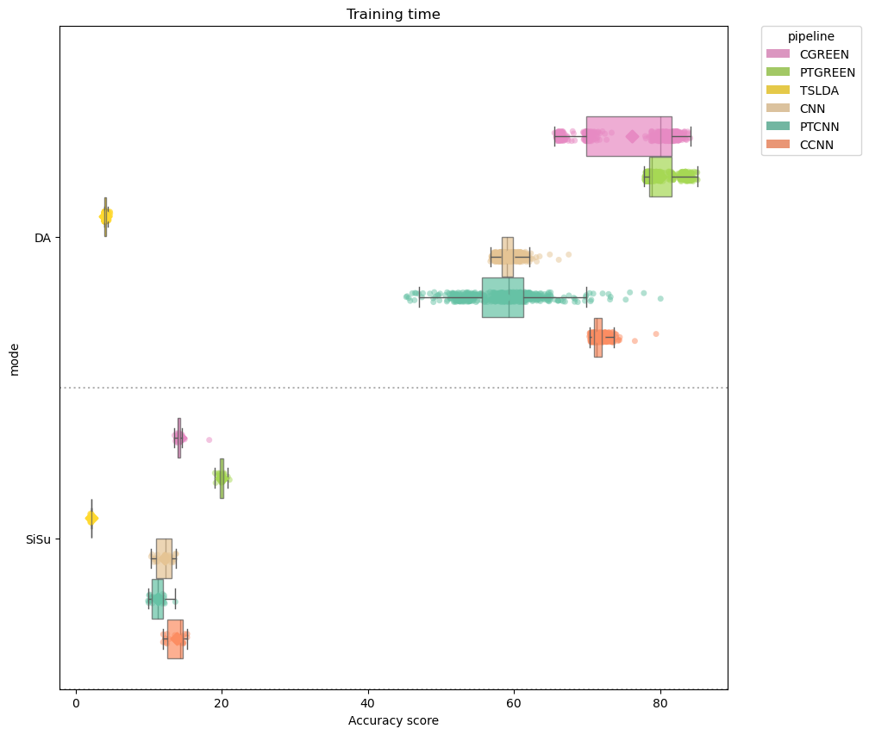
Training time for the classifier
UP: Domain adaptation
Down : Single subject
13

Slide 14
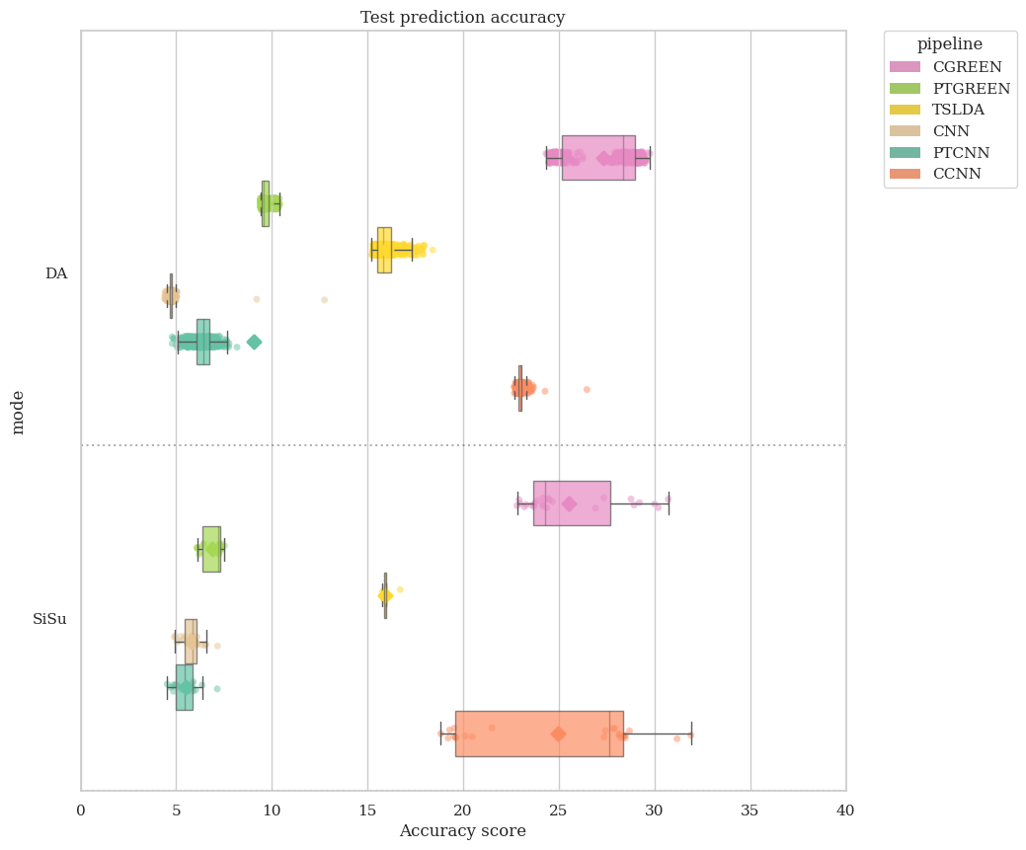
Prediction time of the whole test set
UP: Domain adaptation
Down : Single subject
14

Slide 15
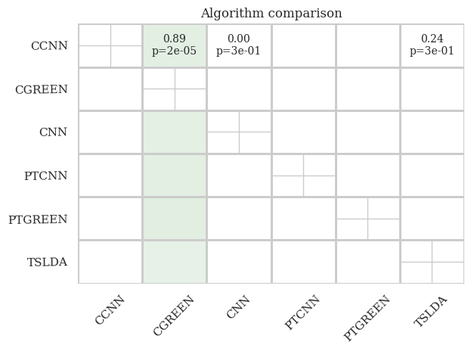
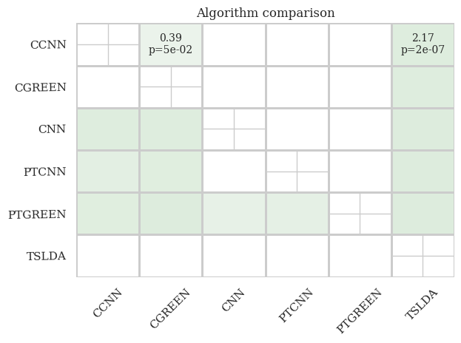
Statistical Study
SiSu
DA
15

Slide 16
InterSubject variability

Slide 17
Context
Burst-CVEP seems more resistant to variabilities and is not the same between the participants
Variabilities seems to be countered with some preprocessing
Does spatial recentering and filtering helps to counter variabilities ?
Does GREEN algorithm induce less variabilities ?
Is it possible to see when a subject will have bad performance beforehand ?
→ It does help
→ GREEN does
→ it could be possible
17

Slide 18
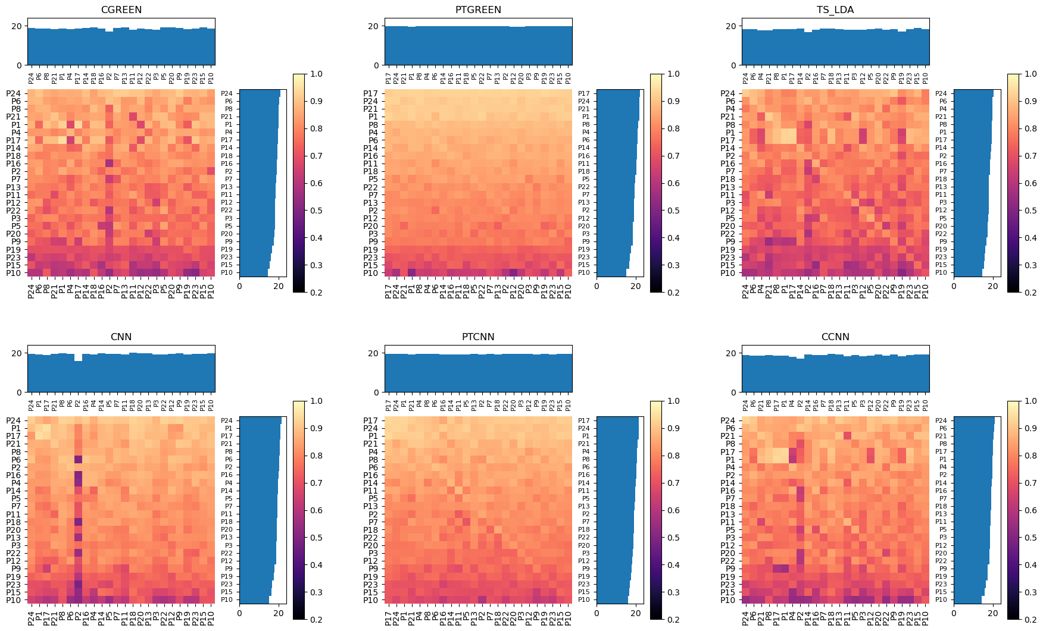
1by1 training/testing matrix
18

Slide 19
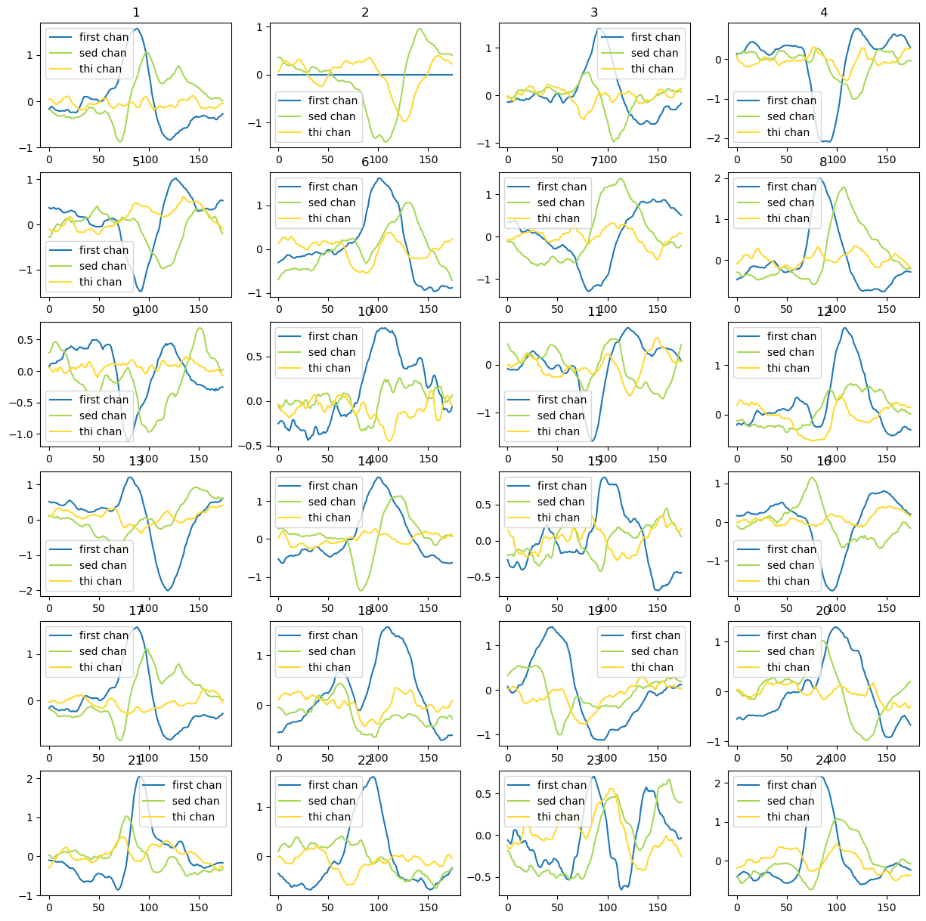
Epochs of the 1st, 2nd, 3rd component of preprocessing for the 24 participants of the dataset
19

Slide 20
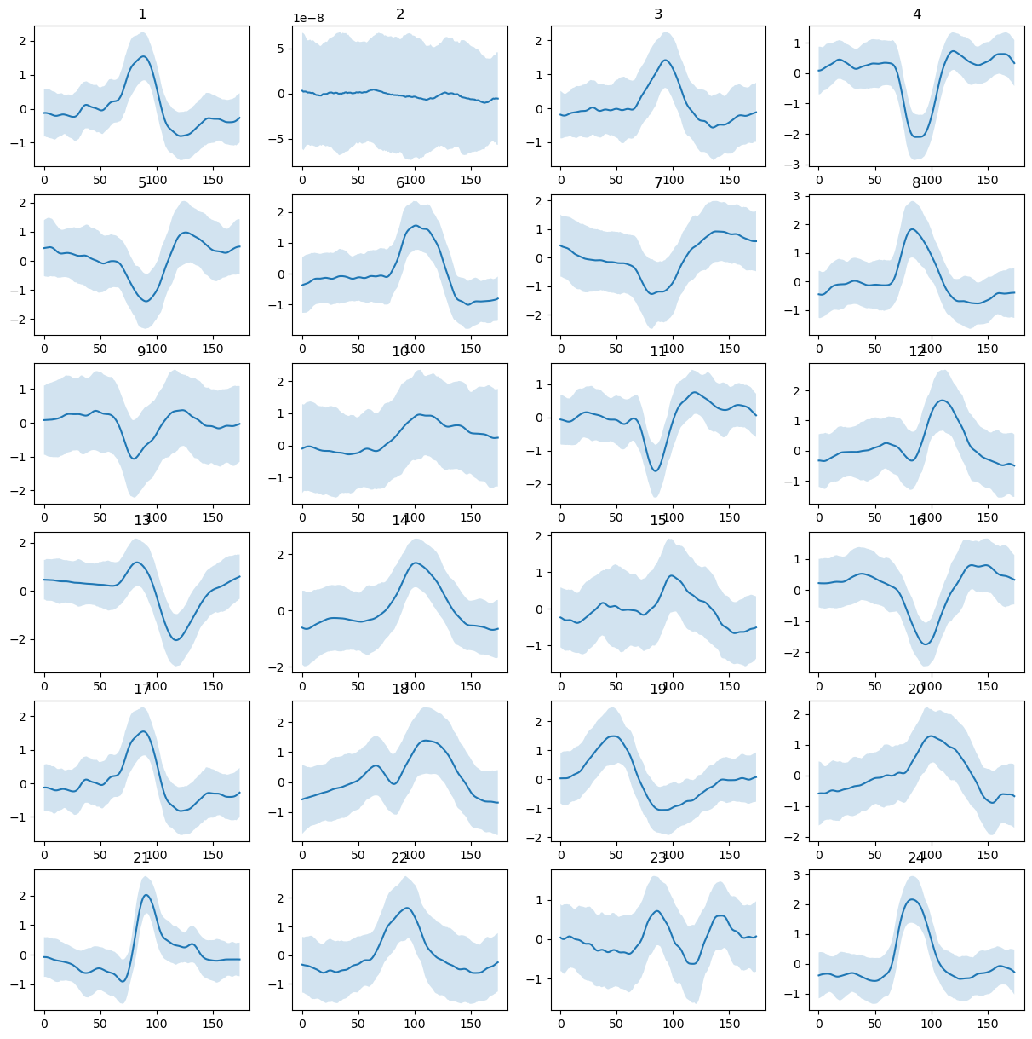
Evoked with InterQuartile range for the 24 participants of the dataset.
20

Slide 21
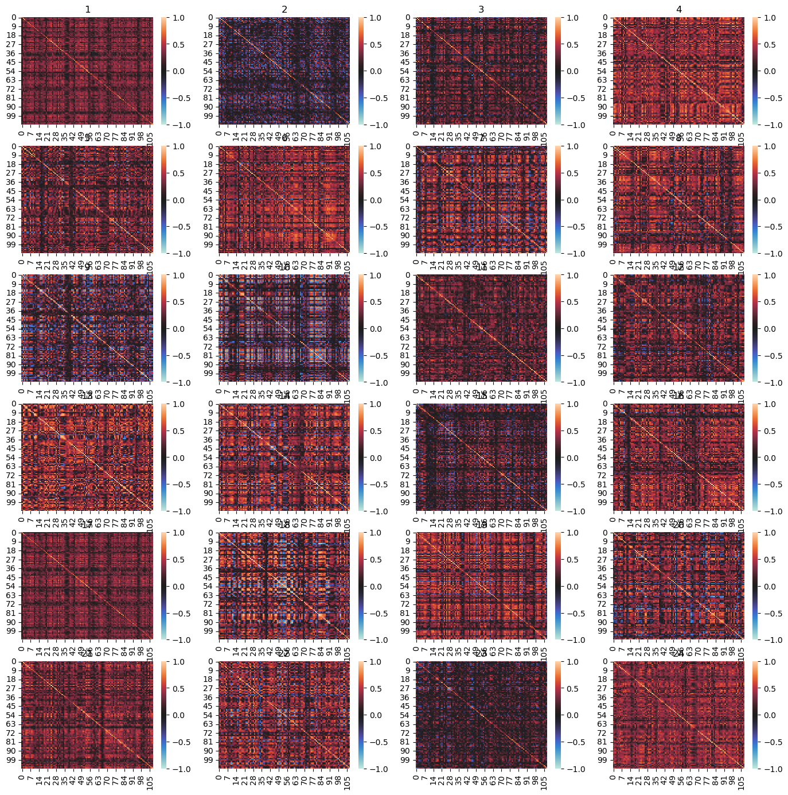
Correlation matrix between all the epochs with label 1 for the 24 participants of the dataset.
21

Slide 22
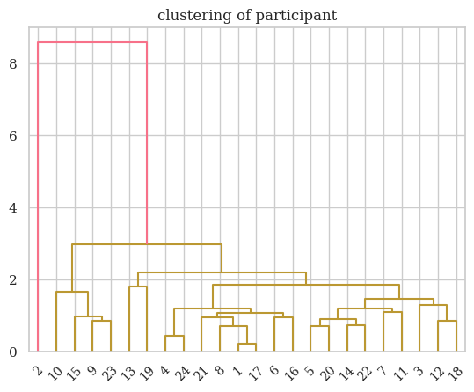
Clustering
Distance used is the addition of :
Riemannian distance
Amplitude distance
Inter Quartile distance
Correlation distance
Time of peak distance
22
Bad subject
Exception
Best subject

Slide 23
Future work

Slide 24
Future Work
Continue these 2 researchs
Write 2 papers (one for Expert System With Application and one for to be determined)
Collaboration with Jord Thielen from mid-March to mid-May
24

Slide 25
Thank you !

Slide 26
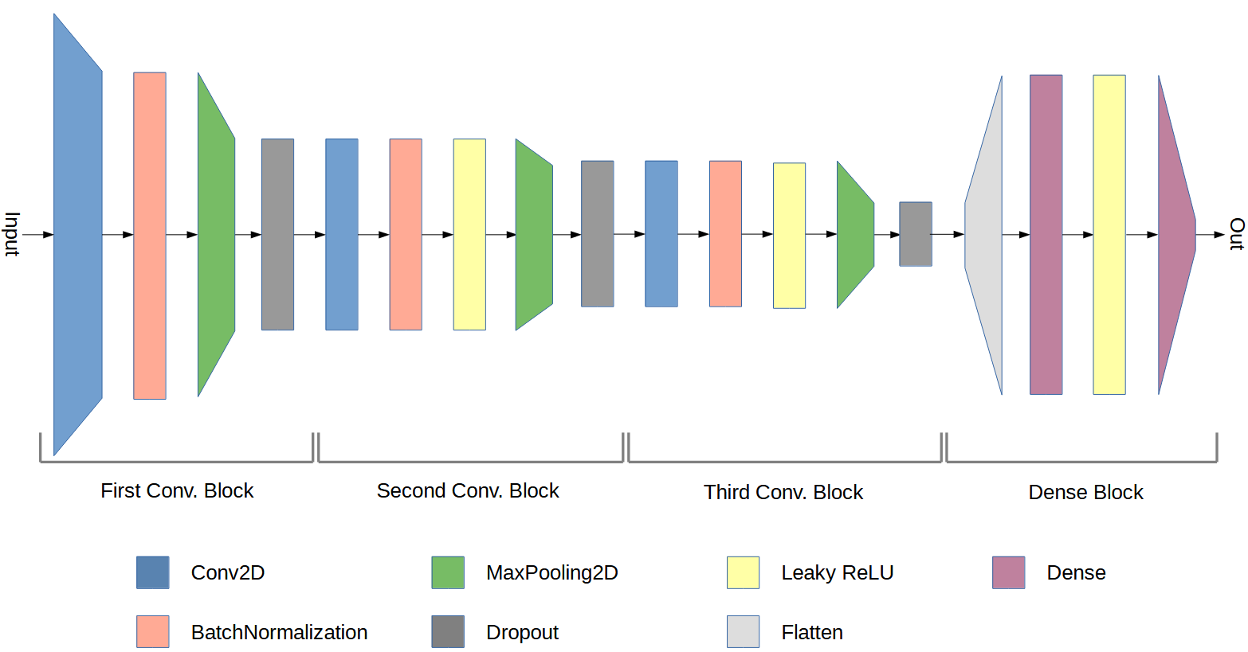
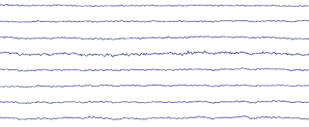

CNN
K. Cabrera Castillos, et al. NeuroImage, page 11, 2023.

Slide 27
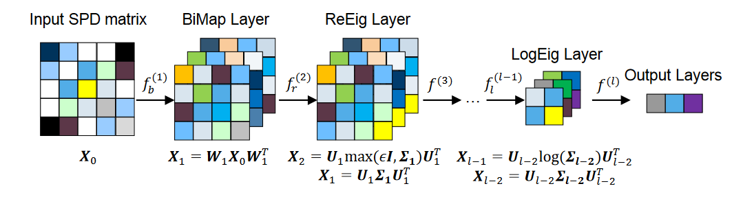
SPDNet
Covariance
transformation
Z. Huang et al. In AAAI, page 9, 2017
R. Kobler et al. In NeurIPS, 2022.

Slide 28
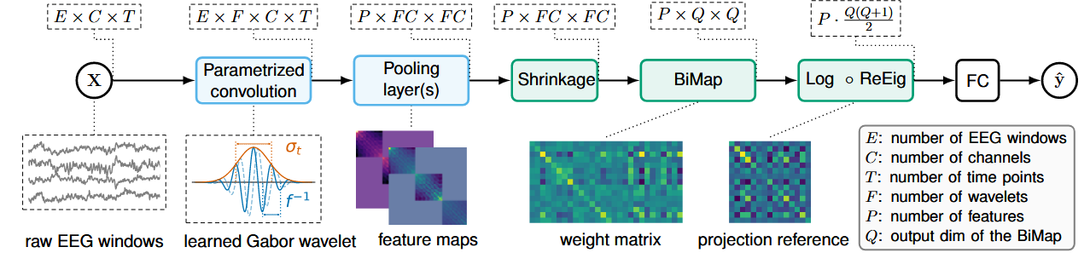
GREEN
Spatial filtering and spatial recentering
Paillard, Joseph & all. (2024)

Slide 29
